Slide 1
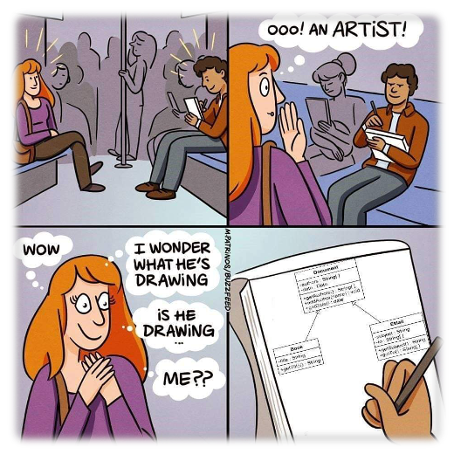
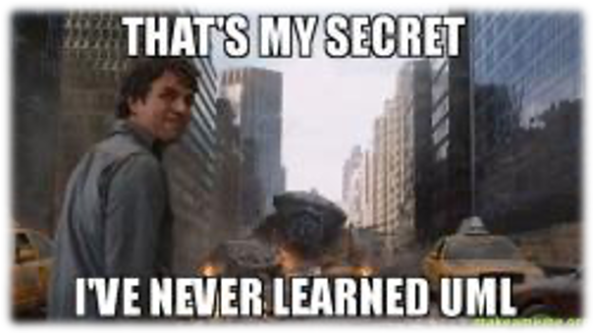
Introduction to the
Unified Modeling Language
OOP
Software Engineering Major
Universidad de las Fuerzas Armadas-ESPE
Computer Science Department
Jorge Edison Lascano
Based on the slides of Dr. Stephen Clyde, Utah State University

Slide 2
Unified Modeling Language
UML is an object-oriented modeling language (or more precisely, a collection of modeling languages) that is
  expressive
  semi-formal
  capable of supporting incremental development
    Elements can be hidden
    Certain elements can be left incomplete
    Inconsistencies can exist
  process independent
    UML can be used with a variety software development process models
  Customizable and extensible

Slide 3
A Brief Timeline for OO and UML
60’s
  Birth of initial OO ideas
70’s
  Nurturing of OO ideas
  Introduction of a few more OO Programming Languages
80’s
  Maturing of fundamental OO concepts
  Emergence of more OOPLs
  OOPLs gain widespread use

Slide 4
A Brief Timeline for OO and UML
90’s
  The Method Wars
  Efforts to unify concepts
  Introduction and standardization of UML
  Emergency of next-generation ideas, like Patterns
Current
  Widespread use of UML
  Widespread use of Full-Life-Cycle development tools

Slide 5
UML Building Blocks
Modeling Elements
  Scoping
  Structural
  Behavioral
  Organizational
  Annotational
  Extension
Diagrams that communicate ideas using the modeling elements
Modeling Elements are like words.
Diagrams are like sentences or paragraphs
Models are like whole papers or books
Student
major: String
gpa: Real
standing: String
Contacts
add(Course)
drop(Course)
-- Handle a registration in
courses
See Fig. 2 for
more details
Registered Student
0..*
is in
Role
0..*
Graduate Course
Course

Slide 6
Modeling Elements
Modeling Elements are building blocks for
constructing conceptual descriptions of systems
Definition and Scope
  Use Cases
  Automation Boundaries
Structural
  Objects
  Classes
  Relations
  Interfaces
  Components
  Nodes
Extension
  Templates
  Stereotypes
Behavioral Things
  Messages
  States
  Transitions
  Events
Organizational Things
  Packages
  Views
Annotation
  Comments
  Specifications
*Note that this is not a complete list

Slide 7
UML Diagrams
Use Case Diagrams
Class Diagrams
Object Diagrams
Interaction Diagrams
  Sequence Diagrams
  Communication Diagrams
State Charts (enhanced State Machines)
Activity Diagrams
Component Diagrams
Deployment Diagrams
*Note that this is not a complete list

Slide 8
Views
A view is a set of diagrams that describe one aspect of a system or describe the system from a given perspective
Views are like the chapters of a book
Some common views:
  Use-case view
  Logical view
  Implementation view
  Process view
  Deployment view

Slide 9
Views and Methods
The construction and ultimate value of a view is that it is closely tie to the process used to create the view.
The process imposes a certain perspective on the modeling activity
To understand a view, one needs to know the intended perspective

Slide 10
Three Software-Engineering Modeling Perspectives
Analysis – for understanding
  The objects represented in the models are real-world objects
  Models focus on problem-domains concepts
  They describe systems as they are
Specification / High-level Design – for solving problems, scoping, and planning
  The models include both real-world and software objects
  The models show automation boundaries
  The models describe what the system is to become
Implementation – for construction
  The objects in the models are mostly software objects
  The models focus on solution-oriented concepts
  The models describe what the software system is or will be

Slide 11
Analysis Perspective
Student
Classes are sets of objects
Classes may include attributes and operations, but more importantly their intents are defined by responsibilities
Relationships are set of links between objects
Components relate to the problem domain
name
major
GPA
standing
interests
-- The set of students know the registration system
Registered Student
0..*
is in
*..0
Course
name
-- The set of possible courses

Slide 12
Specification Perspective
Student^{R}
Classes define abstraction boundaries and encapsulations for software objects
name
major
GPA
standing
interests
-- The set of students know the registration system
Student^{S}
name: String
major: String
GPA: real
standing: Scode
add(Course)
drop(Course)
-- Software representation of students; support registration in courses

Slide 13
Implementation Perspective
StudentDialogBox
Student
create()
doDataExchange()
onDelete()
onInsert()
onOK()
major: String
GPA: Real
standing: String
add(Course)
drop(Course)
-- Interact with user to add
drop courses
-- Handle a registration in
courses
0..1
Course
1
callNumber: Integer
department
number
section
title
CourseList
-- Display a dynamic list
courses

Slide 14
Implementation Perspective
CObject
Classes can represent software components in frameworks, libraries, or external systems
CCmdTarget
CWnd
CDialog
CListBox
StudentDialogBox
0..1
1
CourseList
-- Interact with user to add
drop courses
-- Display a dynamic list
courses

Slide 15
Software Development Activities
Regardless of the process, a software development project typical includes:
  Requirements capture and analysis
  Design
  Implementation
  Deployment
We’ll refer to these as primary software development activities
Notes:
Requirements Capture and Analysis is all about “Understanding”
It Includes:
Brainstorming
Discovering user goals
Exploring use cases or scenarios
Common to a understanding
Design is all about “Coming up with a Solution”
It includes:
Imaging ways to solve problems
Innovation
Scoping
Establish agreement on system’s responsibilities and functionality
Describing system’s inputs and outputs
Implementation is about all “Constructing the Building”
It includes:
Discovering, adopting, or adapting frameworks and tools
Detailed design
Coding
Unit testing
Integration Testing
System Testing
Deployment is about all “Delivery of the Solution”
It includes:
Planning hosting environment(s)
Readying hosting environment(s)
Configuring software component for hosting environment
Packaging
Staging a roll out to end users
Training

Slide 16
Software Development Activities
We accomplish the core software development activities, at least in part, by:
  Managing people & resources (i.e., planning, tracking, reporting, etc.)
  Conceptual Modeling ***
  Coding ***
  Testing ***
  Documenting *
  Managing work artifacts (i.e., configuration management) *
We refer to these as pervasive or cross-cutting software development activities
*** -- Primary focus of this course
** -- Secondary focus of this course
* -- Lightly covered in this course

Slide 17
Types of Diagrams
Structural Diagrams
  Class Diagrams
  Object Diagrams
  Component Diagrams
  Deployment Diagrams
Behavioral Diagrams
  Use Case Diagrams
  Sequence Diagrams
  Collaboration Diagrams
  Statechart Diagrams
  Activity Diagrams

Slide 18
Types of Diagrams
Structural Diagrams
  Class Diagrams
  Object Diagrams
  Component Diagrams
  Deployment Diagrams
Behavioral Diagrams
  Use Case Diagrams
  Sequence Diagrams
  Collaboration Diagrams
  State chart Diagrams
  Activity Diagrams
show classes, interfaces, collaborations, and their relationships
commonly found in OO modeling languages
used to illustrate static design views
can be used to illustrate a static process view of a system

Slide 19
Types of Diagrams
Structural Diagrams
  Class Diagrams
  Object Diagrams
  Component Diagrams
  Deployment Diagrams
Behavioral Diagrams
  Use Case Diagrams
  Sequence Diagrams
  Collaboration Diagrams
  State chart Diagrams
  Activity Diagrams
show objects and their relationships
used to illustrate static snapshots of class instances
address the static design view of static process view of a system
differ from class diagram in that they show individual real or prototypical cases

Slide 20
Types of Diagrams
Structural Diagrams
  Class Diagrams
  Object Diagrams
  Component Diagrams
  Deployment Diagrams
Behavioral Diagrams
  Use Case Diagrams
  Sequence Diagrams
  Collaboration Diagrams
  State chart Diagrams
  Activity Diagrams
show components and their relationships
used to illustrate static implementation views of a system
related to class diagrams in that a component typically maps to one or more classes, interfaces or collaborations

Slide 21
Types of Diagrams
Structural Diagrams
  Class Diagrams
  Object Diagrams
  Component Diagrams
  Deployment Diagrams
Behavioral Diagrams
  Use Case Diagrams
  Sequence Diagrams
  Collaboration Diagrams
  State chart Diagrams
  Activity Diagrams
show nodes and their relationships
used to illustrate static deployment views of an architecture
related to component diagrams in that a node typically encloses one or more components

Slide 22
Types of Diagrams
Structural Diagrams
  Class Diagrams
  Object Diagrams
  Component Diagrams
  Deployment Diagrams
Behavioral Diagrams
  Use Case Diagrams
  Sequence Diagrams
  Collaboration Diagrams
  State chart Diagrams
  Activity Diagrams
show use cases and actors
used to illustrate use case views of a system
help organize and model the behavior of a system

Slide 23
Types of Diagrams
Structural Diagrams
  Class Diagrams
  Object Diagrams
  Component Diagrams
  Deployment Diagrams
Behavioral Diagrams
  Use Case Diagrams
  Sequence Diagrams
  Collaboration Diagrams
  State chart Diagrams
  Activity Diagrams
are interaction diagrams that emphasize the time ordering of messages
show object and the messages that they send or receive
include objects that are named or anonymous
used to illustrate dynamic specific or design views of a system

Slide 24
Types of Diagrams
are interaction diagrams that emphasize the structural organization of communicating objects
show objects, links among those objects, and messages
include objects are are named or anonymous
used to illustrate dynamic views of a system
Structural Diagrams
  Class Diagrams
  Object Diagrams
  Component Diagrams
  Deployment Diagrams
Behavioral Diagrams
  Use Case Diagrams
  Sequence Diagrams
  Collaboration Diagrams
  State chart Diagrams
  Activity Diagrams

Slide 25
Types of Diagrams
show state machines consisting of states, transitions, events, and activities
emphasize event-ordered behavior
used to model behavior of objects in terms of classes, interfaces, or collaborations
used preliminary in design and implementation views
Structural Diagrams
  Class Diagrams
  Object Diagrams
  Component Diagrams
  Deployment Diagrams
Behavioral Diagrams
  Use Case Diagrams
  Sequence Diagrams
  Collaboration Diagrams
  State chart Diagrams
  Activity Diagrams

Slide 26
Types of Diagrams
show flow of activities within a system, their typical ordering (sequential or branching), and the object that act or are acted upon
emphasize flow of control
used to illustrate dynamic specification and design views of a system
Structural Diagrams
  Class Diagrams
  Object Diagrams
  Component Diagrams
  Deployment Diagrams
Behavioral Diagrams
  Use Case Diagrams
  Sequence Diagrams
  Collaboration Diagrams
  State chart Diagrams
  Activity Diagrams

Slide 27
More on Views
Views are collections of diagrams that describe a system from a certain perspective, e.g.
  Use-case view
  Logical view
  Implementation view
  Process view
  Deployment view
Note that you’ll see a wide variation in the prescribed view across different methods or in different textbooks

Slide 28
Modeling Systems From Different Views
Decide which views you need to best complete the software engineering process
  For example, a group calendar system may require all the views mentioned earlier
For each view, decide which types of diagrams you need to capture the essential details
  For example, use case, class, and activity diagrams may make up your Use Case View

Slide 29
Modeling Systems From Different Views
Decide which diagrams you want to place under change control (configuration management)

Slide 30
Modeling Different Levels of Abstraction
Different development activities and discussions require different levels of abstraction
Two ways to model different levels of abstraction:
  using diagrams with different levels of detail from the same model
  creating models at different levels of abstraction, but can be traced from one to another

Slide 31
Modeling Complex Views
First, explore ways of expressing the information at a higher level of abstraction that is still meaningful but reduces complexity
Consider grouping some of the elements in packages or in higher level collaborations
Use notes and color as visual cues
Print the view in its entirety, hang it on a (very) large wall, step back, and look for patterns

Slide 32
Hints and Tips
Remember that the purpose of diagrams is not have pretty pictures, but to visualize, specify, construct, and document, and most importantly COMMUNICATE
Not all diagrams are meant to be preserved
Avoid extraneous or redundant diagrams
Don’t oversimplify
Keep a balance between the structural and behavioral diagrams

Slide 33
Hints and Tips
Give each diagram a meaningful name that clearly expresses its intent
Keep your diagrams organized
  Lay out its elements to minimize lines that cross
  Organize its elements spatially so things that are semantically close are laid out physically close
Group them into packages according to view
Don’t obsess over the format of a diagram
Let tools help you

Slide 34
Some Interesting UML Modeling Questions
How do we discover objects or classes?
When should we focus on problem-domain objects, solution-domain objects, or environment objects?
How can we keep the different perspectives straight?
Should each perspective be captured by a different model or can they all be managed in one model?
How much detail should you put in a diagram, a view, or a model?

Slide 35
More UML Modeling Questions
How should you distribute responsibilities among classes?
  What happens when classes get too big, i.e. inadequate distribution?
  What happens when classes are too small, i.e. too fine of grain distribution?
  What happens when there are a lot of dependency relationships between classes, i.e., inappropriate or ad hoc distribution?

Slide 36
WHAT IS NEXT…
Use Cases

